Slide 1

1
STFT PHASE IMPROVEMENT FOR SINGLE CHANNEL SPEECH ENHANCEMENT
Presented By : Mansi Choudhary, Arunaditya Dash, Harsh Soni
EE 304 |IIT INDORE| 2024

Slide 2
2
INTRODUCTION
In short-time Fourier transform (STFT) based speech enhancement algorithms, only the amplitude of the noisy speech signal is improved, but its phase is left unchanged. It is commonly assumed that the noisy phase is the best estimate of the clean phase available. While using the noisy phase is indeed optimal under certain statistical assumptions, in this paper, it is shown that blindly improving the noisy phase is possible when these, potentially limiting, assumptions are dropped. Without modifying the amplitude, the proposed algorithm leads to SNR improvements of up to 1.8 dB.
EE 304 |IIT INDORE| 2024

Slide 3
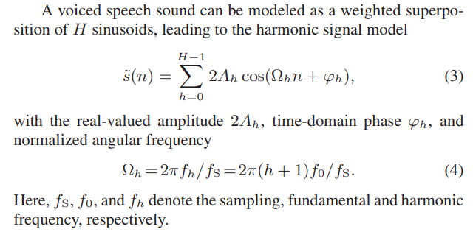
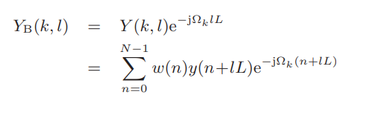
3
METHODOLOGY
We have a speech signal s(n) and noise v(n), i.e. y(n) = s(n) + v(n).
2. Reformulating s(n) using the harmonic signal model of speech signals
EE 304 |IIT INDORE| 2024
1. Baseband STFT form of y(n)

Slide 4
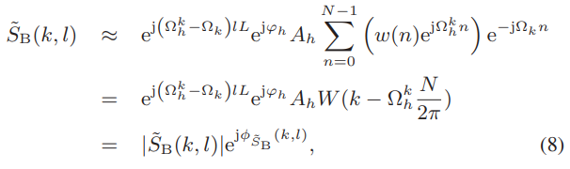


4
METHODOLOGY
EVALUATION & RESULTS
For the evaluation of the proposed algorithm, a randomly chosen subset of 10 speakers taken from the TIMIT database is deteriorated by additive white Gaussian noise with global SNRs ranging from -10 dB to 15 dB. The segment length is set to 32 ms, and a segment shift of 4 ms is chosen to allow for a high temporal resolution. With a sampling frequency of 8 kHz, this corresponds to N = 256 samples and L = 32 samples.
3. Performing Phase Reconstruction
EE 304 |IIT INDORE| 2024
SNR of the noisy signal | Improvement after phase enhancement
1 | 1.3597
5 | 1.1350
8 | 1.0502
11 | 1.0022
4. The reconstructed phase is combined with the noisy amplitude and then demodulated by multiplying by e^{jΩ}_{k}^{lL} , which yields the clean speech estimate

Slide 5
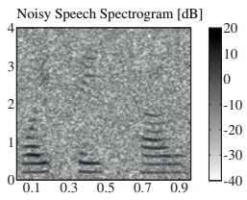
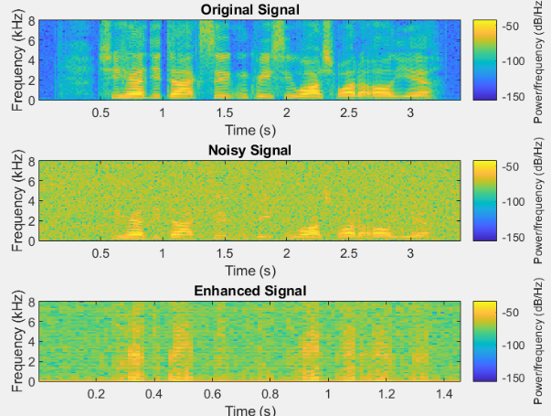
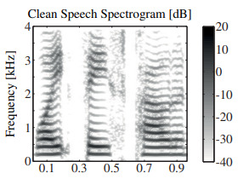
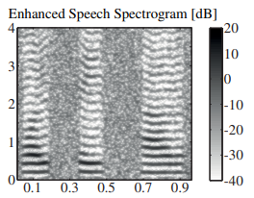
5
IMPLEMENTATION
OBSERVATION
As in research paper:
Initial SNR: 5dB
EE 304 |IIT INDORE| 2024
CONCLUSION
We implemented an algorithm for the enhancement of noisy speech, based on STFT-phase reconstruction during voiced segments. It is shown that with phase enhancement alone, an improvement of signal quality can be achieved. Besides the stand-alone performance of this method, a combination with STFT-amplitude enhancement algorithms may lead to further improvements in the quality of speech signals.
Reference Paper:
STFT PHASE IMPROVEMENT FOR SINGLE CHANNEL SPEECH ENHANCEMENT
Martin Krawczyk, Timo Gerkmann
Speech Signal Processing Group, Institute of Physics, University of Oldenburg, Germany

